Slide 1
SALES DATA ANALYSIS ADVANCED EXCEl
MAUL SRI M
03/01/2025
DATA ANALYTICS
JULY-ONLINE-FN

Slide 2
Overview & oBJECTIVE
Understanding Product performance.
Identify highest product contribution.
Measure the impact of discount.
Visually engaging dashboard.

Slide 3
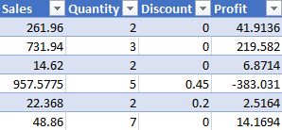
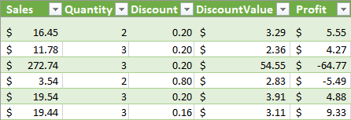
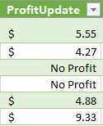
DESCRIPTION and preparation
Ensure consistent data.
Addressed missing values in discount.
Filtered outliers in sales and discounts.
Extracted and Standardized formats.

Slide 4
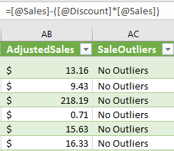
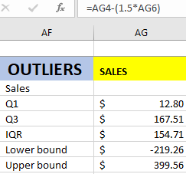
DATA ANALYSIS
Assess the impact of discount on revenue.
Identify the most effective sales channel.
Measure overall sales performance.
Identify the average contribution of each transaction.

Slide 5
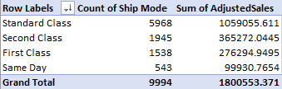
PIVOT TABLES/cHARTS
Standard class comparatively high.
Balanced contribution.
Dissecting sales for trends.

Slide 6
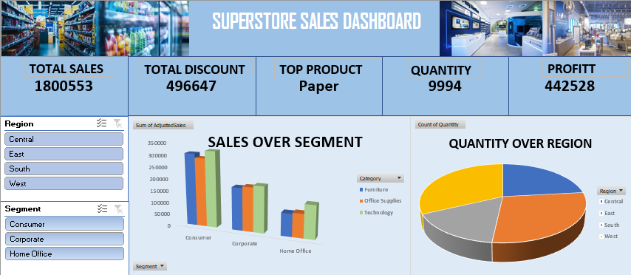
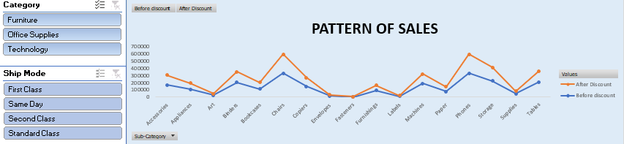
DASHBOARD
Organized review and analysis.
Monitor key processes
Evaluate consumer ability.
Quantifiable measure of performance.

Slide 7
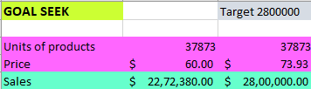
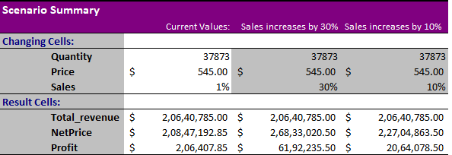
What if analysis & Goal seek
Estimate the effect of profit/discount.
Attempts to describe event.
Internally consistent view of future.
Deliver unique output.

Slide 8
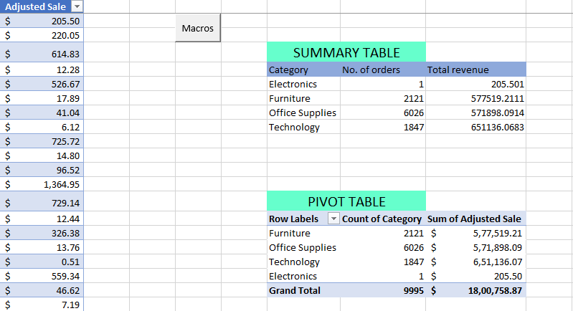
MACROS
Automate
specified task.
Easier to done repetitive task.
Should save in proper manner.

Slide 9
Insights and recommendation
Standard class achieved highest sale.
Technology category is best performing .
Discounting may increases sale.
Ease of purchase.

Slide 10
CONCLUSION
Enhance customer relationship.
Analyse sales cycle by KPI’s.
Discontinue underperforming products.
Winning sales opportunity.

Slide 11
Any queries?

Slide 12
Thank you

